Slide 1

AKS Office Hours
Kendall Roden
Cloud Native Technical Specialist
Kendal Roden
Cloud Native Technical Specialist
Dave Strebel
Cloud Native Technical Specialist

Slide 2

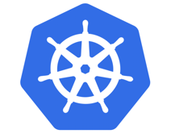


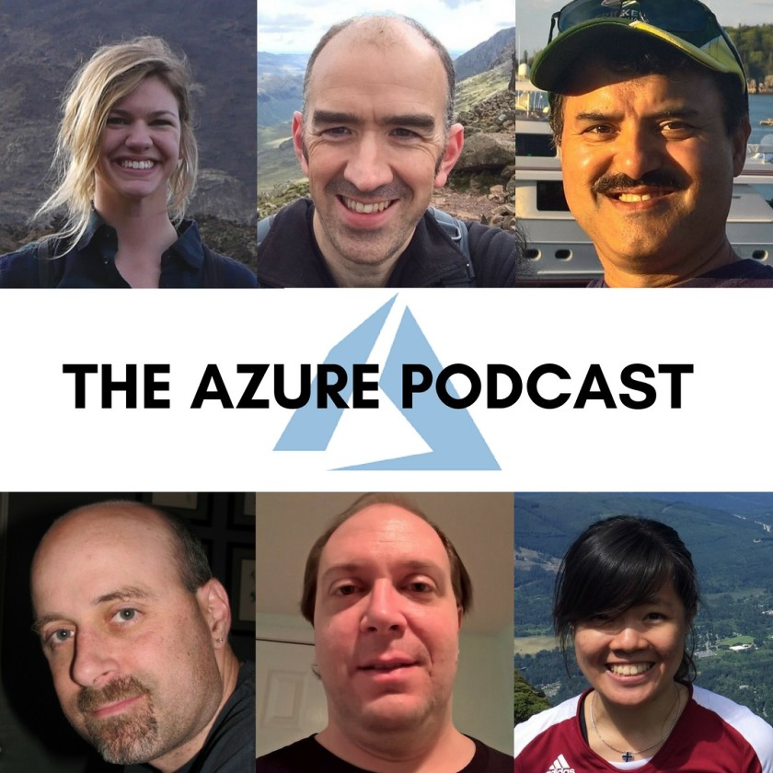


Who are we?
@kendallroden​
@dave_strebel​

Slide 3
Why AKS Office Hours?
Provide AKS customers with updates pertaining to AKS and the Cloud Native Ecosystem
Host a short talk and/or demo on Cloud Native technologies related to Kubernetes and AKS
Collect feedback from customers on issues, blockers, use cases, and questions related to AKS

Slide 4
What to expect
Call agenda
5-10 minutes: Welcome, followed by AKS and ecosystem updates
20-30 minutes: OSM Discussion
20-30 minutes: “Ask us anything” and customer feedback discussion
Keep in mind
We want two-way interaction, but please stay on mute when you are not speaking
This call and how it is conducted will evolve based on feedback and growth
Recordings and content will be available post-call, barring any technical difficulties

Slide 5

AKS Updates

Slide 6
AKS Updates
CSI Driver will become default for Kubernetes versions 1.21+
Automatic Node Image Update in preview
OSM Add-on in preview
PSP deprecation moved to 1.21 and removal in 1.25
Notes:
Previous ones:
Pod security policy (preview) feature retirement = May 31st, 2021
Once GA, AKS will default to its new GPU specialized image
1.16.x clusters cannot be created anymore
New:
Simplified access for integration with AAD including support for Conditional Access
No admin accounts if desired
Release Notes: https://github.com/Azure/AKS/releases/tag/2021-01-25
Azure AD Conditional Access: https://docs.microsoft.com/azure/aks/managed-aad#use-conditional-access-with-azure-ad-and-aks
Auto-upgrade channel: https://docs.microsoft.com/en-us/azure/aks/upgrade-cluster#set-auto-upgrade-channel-preview

Slide 7
Ecosystem Updates

Slide 8

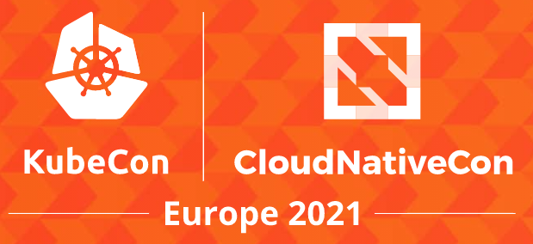



Open Source and Ecosystem call outs
Pulumi 3.0 Released
Native Providers for Azure (GA) and GCP (Beta)
Improved SDKs for Python and Go
CI/CD Assistant
KubeCon EU – May 4th – 7th
Virtual event ($75 all-access pass
25+ Co-Located Events
Kubespoit by Cyberark – Cross-platform post-exploitation dedicated for containerized environments
Open Policy Agent moves to gradute status in CNCF
ArgoCD 2.0 and Argo Workflows 3.0 released
The Cloud Native Landscape: The Application Definition and Development Layer – The New Stack
Notes:
Cloud Native IDEs- think GitHub Codespaces (beta)
K8s on the edge
Cloud Native + Web Assembly (Wasm)
Rise of FinOps- KubeCost – Linux foundation launch the finops foundation to help innovation for managing cloud cost
More rust
Gitops
Service catalogs- cn developer dashboards
Cross cloud
eBPF extending the behavior of the linux kernel – projects like falco and cilium are eBPF based (sandboxed extension mechanism for the kernel)

Slide 9
Open Service Mesh

Slide 10
Agenda
Service Mesh: What, Why and How
Open Service Mesh (OSM) Add-On for AKS
Demo
Q&A

Slide 11
What is a Service Mesh
Decouples application from operational capabilities and moves them out of the application layer, and down to the infrastructure
Provides capabilities like:
Encryption of east to west traffic – Enable mutual TLS between service to service
Traffic Management – Canary and phased rollouts
Control traffic through policy
Observability – Gain insight into how your services are connected and their traffic flows.
Notes:
So as companies began to refactor and/or re-platform their applications following a microservice model, the complexity of controlling communications between these applications with traditional methods becomes more and more complex to manage.
And a lot the complexity comes with a traditional operational approach that may not scale with these new systems that are providing microservices hosting platforms such as Kubernetes, so we need a new approach and that gave birth to what’s now known as a service mesh

Slide 12
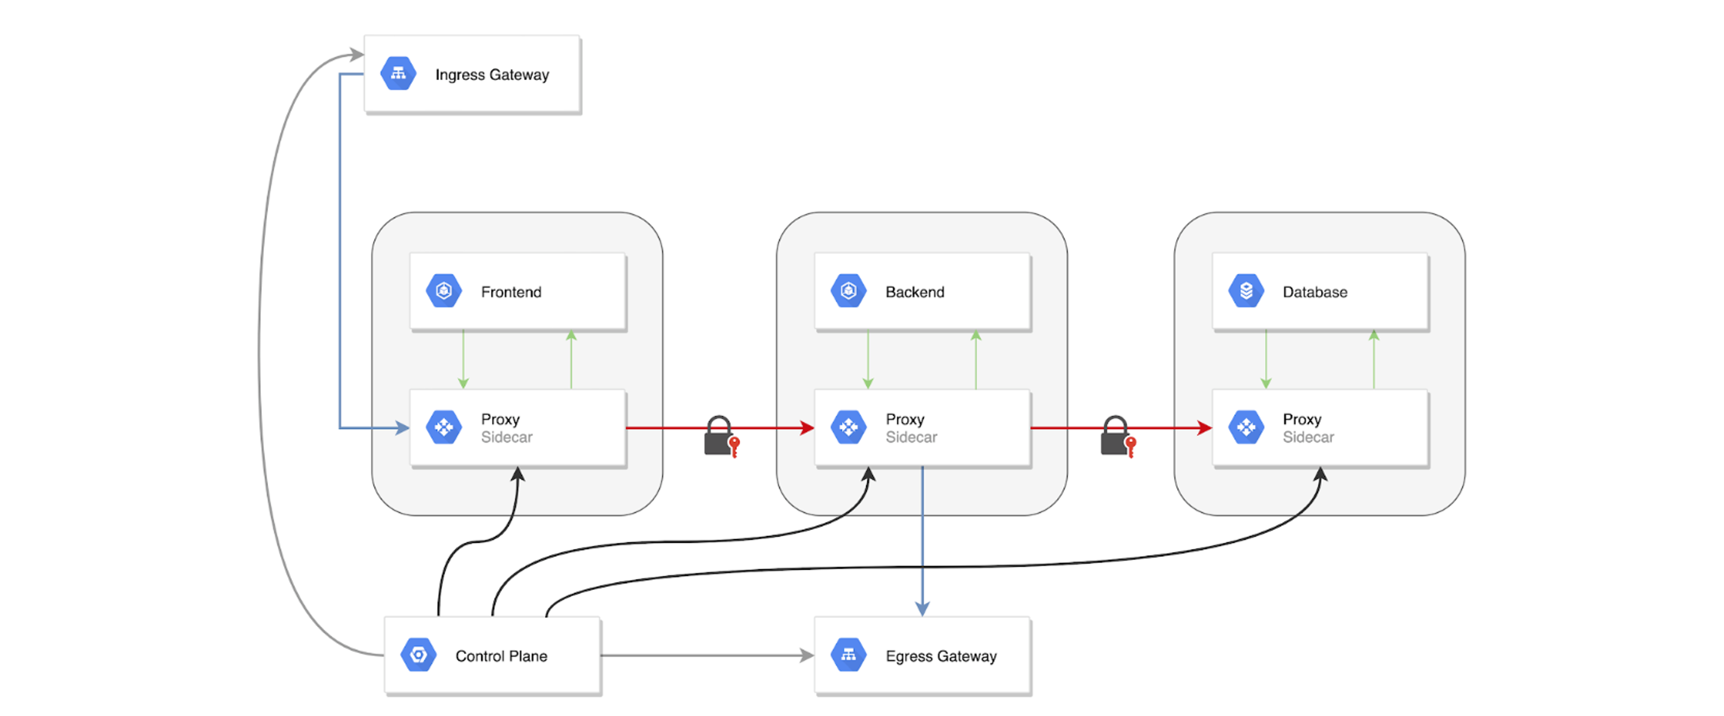
Service Mesh Traffic Overview
Notes:
So if you think about what you maybe doing today with a traditional 3-tier application. Your application code probably has logic to go retrieve a certificate from a certificate authority and then continuously make calls back to the CA to see if anyone else it needs to talk to has been signed a certificate from the same chain of trust, so that they can establish a secure channel of communication.
Or in some cases if you wanted to only secure the type of protocol or endpoints you can accept and reach requires a lot of configuration at the network level.
With a service mesh, what you see here in the 3-tier application is an additional component called a sidecar proxy. The sidecar proxy is now intercepting and handling all the traffic for each tier of the application and it is receiving access policy from a centralized control plane on what type of traffic to allow through the proxy and what other proxies it can communicate to. This now offloads all the previous application logic for securing communication to the sidecar proxy that is receiving policy from a centralized control plane.
And now this is one less thing your application developers need to manage in their applications. They can completely offload this function of securing traffic to the service mesh

Slide 13
When Do I need a Service Mesh?
Your microservices are all written in one language
Org dedicates engineers to building specific tooling and instrumentation
Have a partially or totally monolithic architecture
You release all-at-once
Use protocols not served by current service meshes
Notes:
The urgency of considering a service mesh depends on your organization’s challenges and goals, but can also be considered by your current process or state of operations.
Here are some states that may reduce or eliminate your urgency to use a service mesh:

Slide 14
When Do I need a Service Mesh? (cont)
You have microservices written in different languages
Your teams are re-solving utility code (i.e. cert rotation)
You have stringent security needs
Your teams spends more time understanding than fixing
Need observability across boundaries

Slide 15
Limitations of Service Meshes
Introduction of proxies, side cars and other components can add complexity to platform architecture
Expertise in Kubernetes, networking, and service mesh solutions is needed.
Can have a performance impact
Cost of service mesh

Slide 16
Open Service Mesh
Work in progress v0.7
Utilizes Envoy proxy
Uses Service Mesh Interface (SMI)
Secure end-to-end service to service communication by enabling mTLS
Define and execute fine grained access control policies for services
Observability and insights into application metrics for debugging and monitoring services
Integrate with external certificate management services/solutions with a pluggable interface
Easily and transparently configure traffic shifting for deployments
Notes:
If you think about the whole 80/20 rule, we again focused on the 80% of major needs and functionality to be made easy to do.

Slide 17
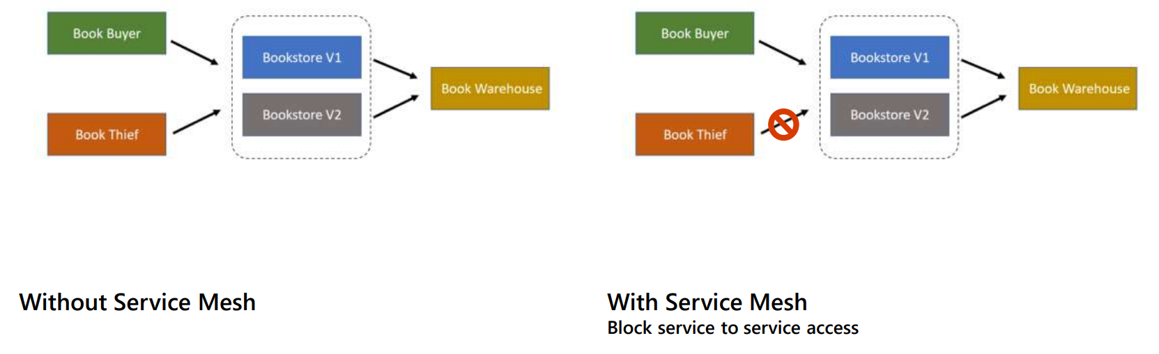
Demo Scenario

Slide 18
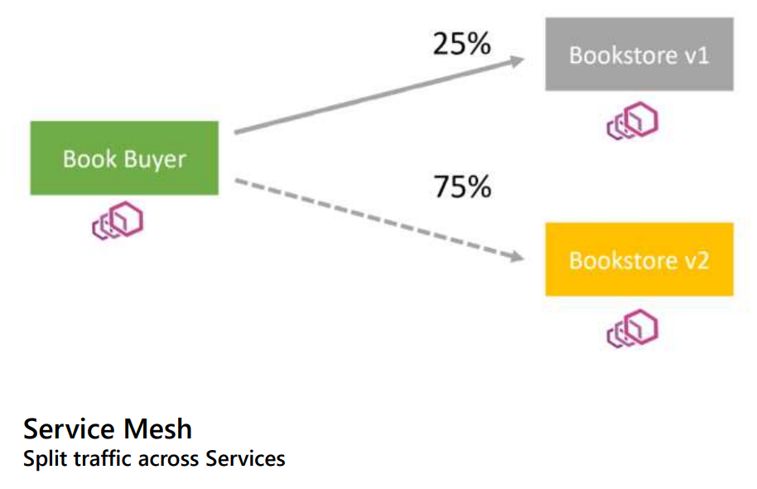
Demo Scenario 2

Slide 19


Demo Time!
Notes:
Cut video feed for demo environment

